Slide 1
Course Name: Database Systems Course Code: CS52 Credits: 3:1:0 UNIT 4 Term: Oct 2021-Feb 2022
M.S. Ramaiah Institute of Technology
(Autonomous Institute, Affiliated to VTU)
Department of Computer Science and Engineering
Faculty:
Sini Anna Alex

Slide 2
Chapter Outline
1. Informal Design Guidelines for Relational Databases.
2. Basics of Functional Dependencies
3. Inference Rules
4. Normalization for Relational Databases

Slide 3
Informal Design Guidelines for Relational Databases
What is relational database design?
The grouping of attributes to form "good" relation schemas
Two levels of relation schemas
The logical "user view" level
The storage "base relation" level
Design is concerned mainly with base relations
What are the criteria for "good" base relations?

Slide 4
Informal Design Guidelines for Relational Databases
We first discuss informal guidelines for good relational design
Then we discuss formal concepts of functional dependencies and normal forms
- 1NF (First Normal Form)
- 2NF (Second Normal Form)
- 3NF (Third Normal Form)
- BCNF (Boyce-Codd Normal Form)
Additional types of dependencies, further normal forms, relational design algorithms by synthesis will be discussing later

Slide 5
Informal Design Guidelines for Relational Databases
1.1 Semantics of the Relation Attributes
1.2 Redundant Information in Tuples and Update Anomalies
1.3 Null Values in Tuples
1.4 Spurious Tuples

Slide 6
1.1 Semantics of the Relational Attributes must be clear
GUIDELINE 1: Informally, each tuple in a relation should represent one entity or relationship instance. (Applies to individual relations and their attributes).
Attributes of different entities (EMPLOYEEs, DEPARTMENTs, PROJECTs) should not be mixed in the same relation
Only foreign keys should be used to refer to other entities
Entity and relationship attributes should be kept apart as much as possible.
Bottom Line: Design a schema that can be explained easily relation by relation. The semantics of attributes should be easy to interpret.

Slide 7
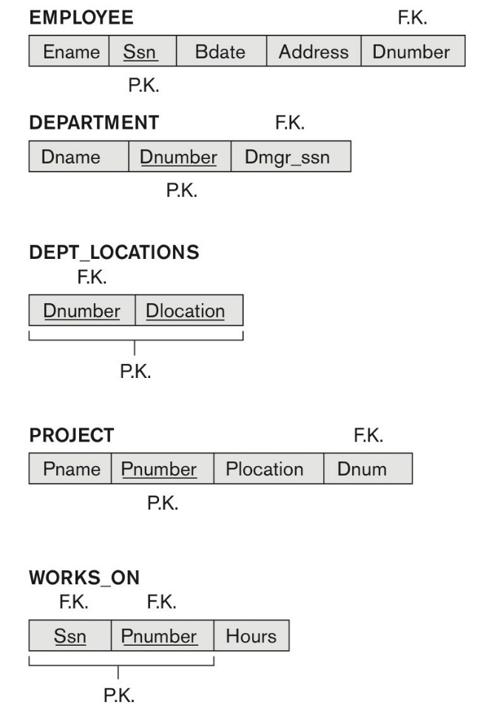
A simplified COMPANY relational database schema

Slide 8
1.2 Redundant Information in Tuples and Update Anomalies
Information is stored redundantly
Causes problems with update anomalies
Wastes storage
Insertion anomalies
Deletion anomalies
Modification anomalies

Slide 9
EXAMPLE OF AN UPDATE ANOMALY
Consider the relation:
EMP_PROJ(Emp#, Proj#, Ename, Pname, No_hours)
Update Anomaly:
Changing the name of project number P1 from “Billing” to “Customer-Accounting” may cause this update to be made for all 100 employees working on project P1.
Update Anomaly: Let say we have 10 columns in a table out of which 2 are called employee Name and employee address. Now if one employee changes it’s location then we would have to update the table. But the problem is, if the table is not normalized one employee can have multiple entries and while updating all of those entries one of them might get missed.

Slide 10
EXAMPLE OF AN INSERT ANOMALY
Consider the relation:
EMP_PROJ(Emp#, Proj#, Ename, Pname, No_hours)
Insert Anomaly:
Cannot insert a project unless an employee is assigned to it.
Conversely
Cannot insert an employee unless an he/she is assigned to a project.

Slide 11
EXAMPLE OF AN DELETE ANOMALY
Consider the relation:
EMP_PROJ(Emp#, Proj#, Ename, Pname, No_hours)
Delete Anomaly:
When a project is deleted, it will result in deleting all the employees who work on that project.
Alternately, if an employee is the sole employee on a project, deleting that employee would result in deleting the corresponding project.
Deletion Anomaly: This anomaly indicates unnecessary deletion of important information from the table. Let’s say we have student’s information and courses they have taken as follows (student ID,Student Name, Course, address). If any student leaves the school then the entry related to that student will be deleted. However, that deletion will also delete the course information even though course depends upon the school and not the student.

Slide 12
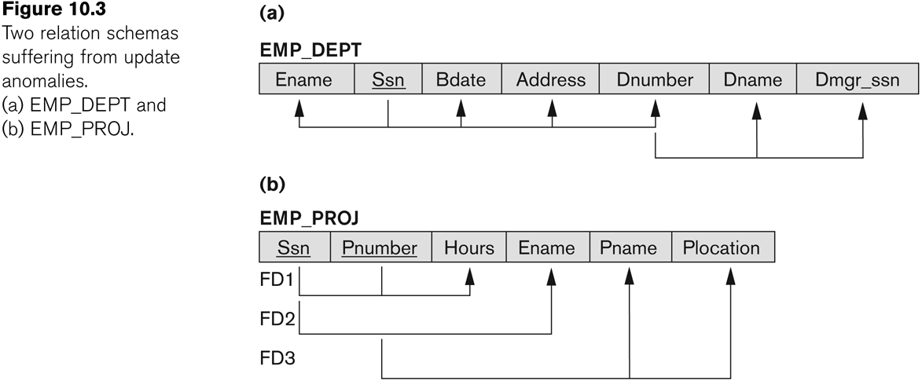
Figure : Two relation schemas suffering from update anomalies

Slide 13
Guideline to Redundant Information in Tuples and Update Anomalies
GUIDELINE 2:
Design a schema that does not suffer from the insertion, deletion and update anomalies.
If there are any anomalies present, then note them so that applications can be made to take them into account.

Slide 14
Null Values in Tuples
GUIDELINE 3:
Relations should be designed such that their tuples will have as few NULL values as possible
Attributes that are NULL frequently could be placed in separate relations (with the primary key)
Reasons for nulls:
Attribute not applicable or invalid
Attribute value unknown (may exist)
Value known to exist, but unavailable

Slide 15
Spurious Tuples
Bad designs for a relational database may result in erroneous results for certain JOIN operations
The "lossless join" property is used to guarantee meaningful results for join operations.
A “tuple” is a record in a database: a row in a spreadsheet.
A spurious tuple is, basically, a record in a database that gets created when two tables are joined badly. In database, spurious tuples are created when two tables are joined on attributes that are neither primary keys nor foreign keys.
GUIDELINE 4:
The relations should be designed to satisfy the lossless join condition.
No spurious tuples should be generated by doing a natural-join of any relations.

Slide 16
Spurious Tuples contd..
There are two important properties of decompositions:
Non-additive or losslessness of the corresponding join
Preservation of the functional dependencies.
Note that:
Property (a) is extremely important and cannot be sacrificed.
Property (b) is less stringent and may be sacrificed.

Slide 17
Guidelines - summary
GUIDELINE 1: Design a schema that can be explained easily relation by relation. The semantics of attributes should be easy to interpret.
GUIDELINE 2: Design a schema that does not suffer from the insertion, deletion and update anomalies. If there are any present, then note them so that applications can be made to take them into account
GUIDELINE 3: Relations should be designed such that their tuples will have as few NULL values as possible
GUIDELINE 4: The relations should be designed to satisfy the lossless join condition. No spurious tuples should be generated by doing a natural-join of any relations.

Slide 18
Not all designs are equally good
Why is this design bad?
Data(sid,sname,address,cid,cname,grade)
Why is this one preferable? Student(sid,sname,address) Course(cid,cname) Enrolled(sid,cid,grade)

Slide 19
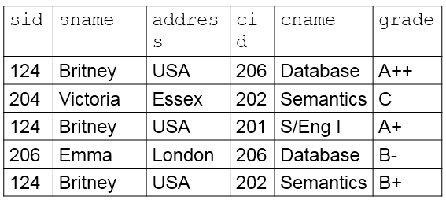
An instance of our bad design
Recall:
A key is a set of fields where if a pair of tuples agree on a key, they agree everywhere.
In our bad design, if two tuples agree on sid, then they also agree on address, even though the rest of the tuples may not agree

Slide 20
Functional Dependencies
Functional dependencies (FDs)
Are used to specify formal measures of the "goodness" of relational designs
And keys are used to define normal forms for relations
Are constraints that are derived from the meaning and interrelationships of the data attributes
A set of attributes X functionally determines a set of attributes Y if the value of X determines a unique value for Y

Slide 21
Functional Dependencies
X -> Y holds if whenever two tuples have the same value for X, they must have the same value for Y
For any two tuples t1 and t2 in any relation instance r(R): If t1[X]=t2[X], then t1[Y]=t2[Y]
X -> Y in R specifies a constraint on all relation instances r(R)
Written as X -> Y; can be displayed graphically on a relation schema. ( denoted by the arrow: ).
FDs are derived from the real-world constraints on the attributes

Slide 22
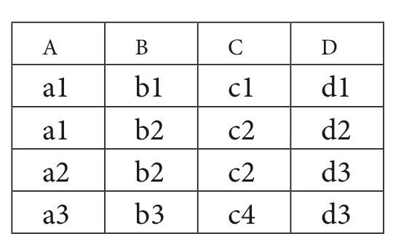
Figure: What FDs may exist?
A relation R(A, B, C, D) with its extension.
Which FDs may exist in this relation?
The following FDs may hold B->C, C->B
The following FDs do not hold A->B, B->A, D->C
We denote by F the set of functional dependencies specified on relation schema R.

Slide 23
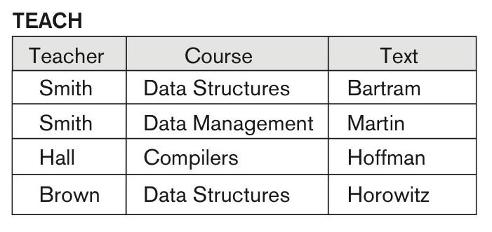
Ruling Out FDs
Note that given the state of the TEACH relation, The FDs Teacher → Course, Teacher → Text and Couse → Text are ruled out.

Slide 24
Examples of FD constraints
Social security number determines employee name
SSN -> ENAME
Project number determines project name and location
PNUMBER -> {PNAME, PLOCATION}
Employee ssn and project number determines the hours per week that the employee works on the project
{SSN, PNUMBER} -> HOURS

Slide 25
FD constraints
An FD is a property of the attributes in the schema R
The constraint must hold on every relation instance r(R)
If K is a key of R, then K functionally determines all attributes in R
(since we never have two distinct tuples with t1[K]=t2[K])

Slide 26
Inference Rules for FDs
Given a set of FDs F, we can infer additional FDs that hold whenever the FDs in F hold
Armstrong's inference rules:
IR1. (Reflexive) If Y subset-of X, then X -> Y
IR2. (Augmentation) If X -> Y, then XZ -> YZ
(Notation: XZ stands for X U Z)
IR3. (Transitive) If X -> Y and Y -> Z, then X -> Z
IR1, IR2, IR3 form a sound and complete set of inference rules
These are rules hold and all other rules that hold can be deduced from these

Slide 27
Inference Rules for FDs
Some additional inference rules that are useful:
Decomposition: If X -> YZ, then X -> Y and X -> Z
Union: If X -> Y and X -> Z, then X -> YZ
Psuedotransitivity: If X -> Y and WY -> Z, then WX -> Z
The last three inference rules, as well as any other inference rules, can be deduced from IR1, IR2, and IR3 (completeness property)

Slide 28
Thank you

